Slide 1
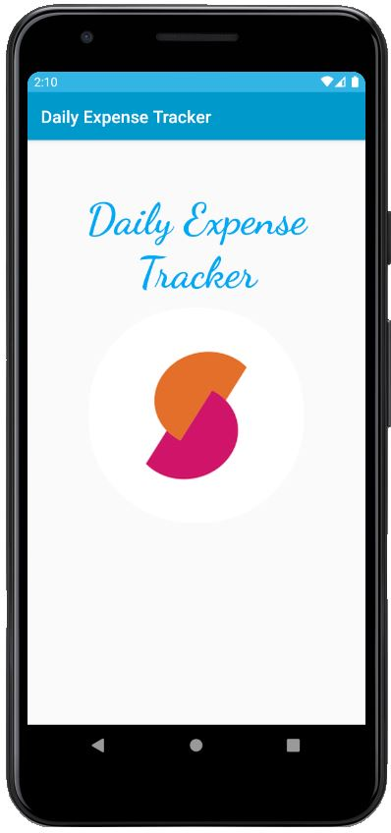
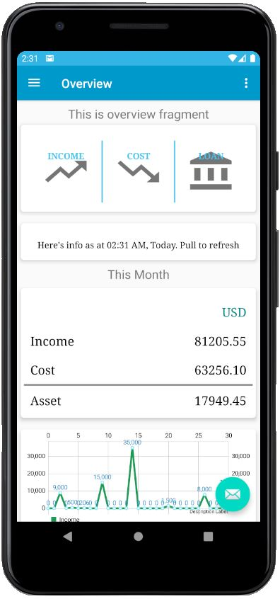

Daily Expense Tracker
Maintain your daily income
Maintain your daily cost/expenses
Maintain your loan/Leasing
Maintain your loan and leasing installment plan
Check current status of your loan and leasing account
Summarized you monthly asset
Summarized you yearly asset
Money saving plan (Budget)
Graphically view of monthly income status
Graphically view of monthly cost/expense status
Latest News Update

Slide 2
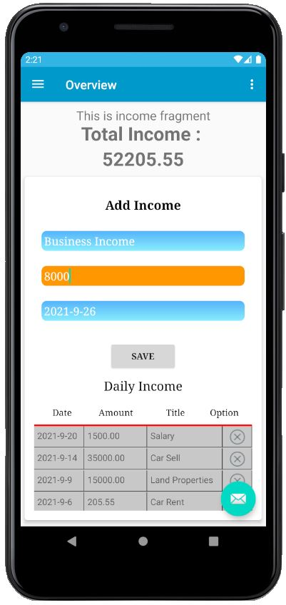
Daily Expense Tracker
Maintain your daily income

Slide 3
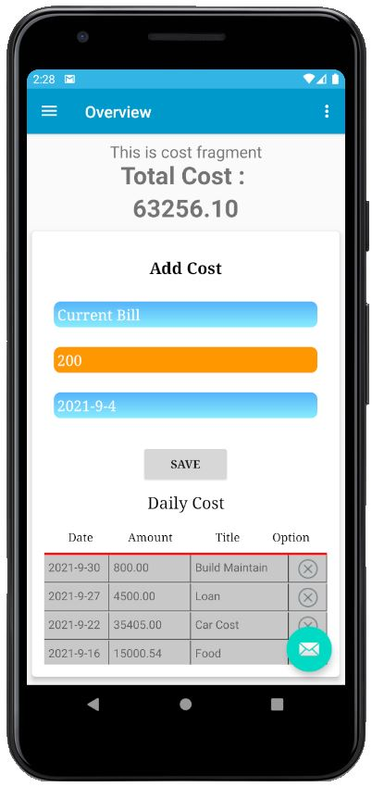
Daily Expense Tracker
Maintain your daily cost/expenses

Slide 4
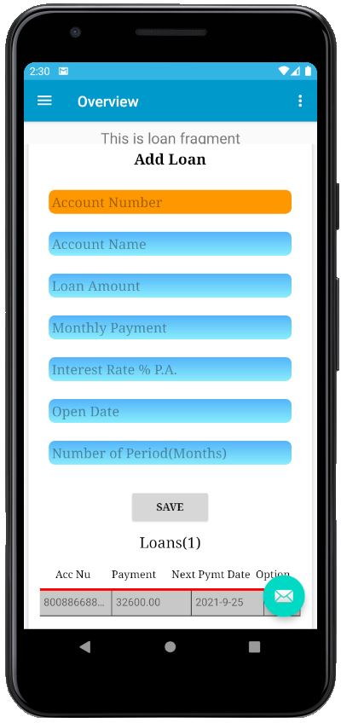
Daily Expense Tracker
Maintain your loan/Leasing

Slide 5
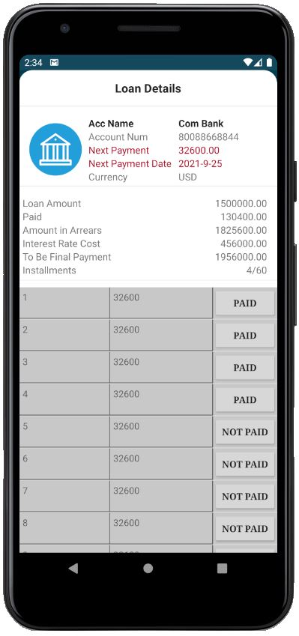
Daily Expense Tracker
Maintain your loan and leasing installment plan
Check current status of your loan and leasing account

Slide 6
Daily Expense Tracker
Summarized you monthly asset

Slide 7
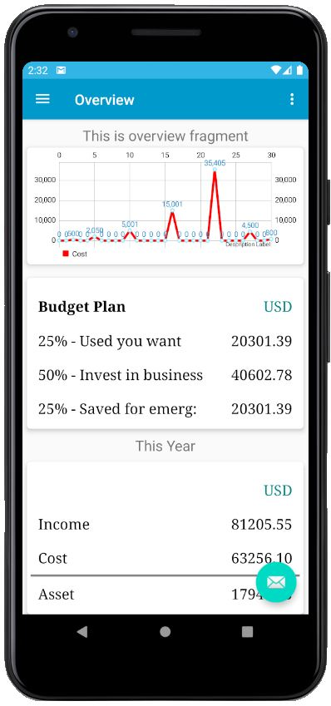
Daily Expense Tracker
Summarized you yearly asset
Money saving plan (Budget)

Slide 8
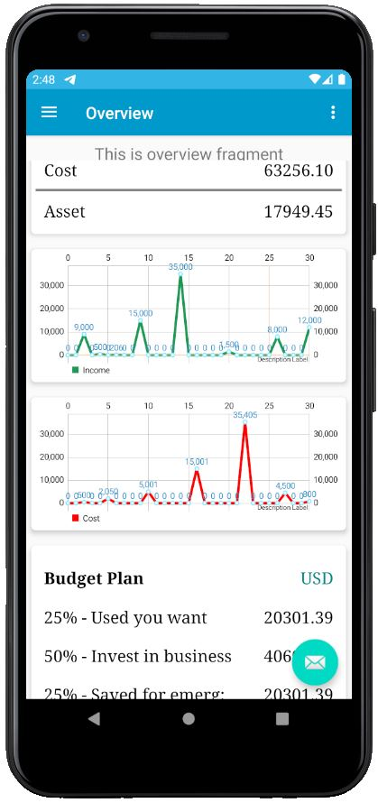
Daily Expense Tracker
Graphically view of monthly income status
Graphically view of monthly cost/expense status

Slide 9
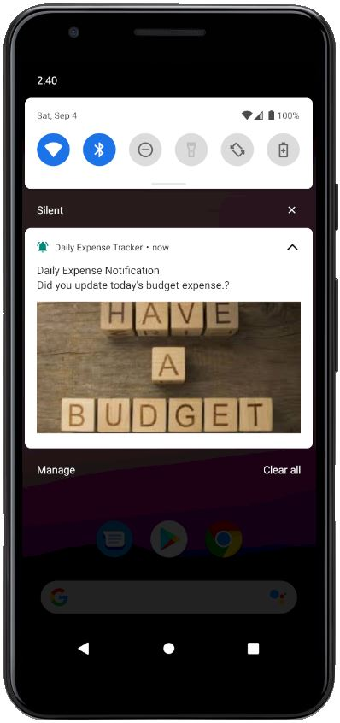
Daily Expense Tracker
Latest News Update

Slide 10
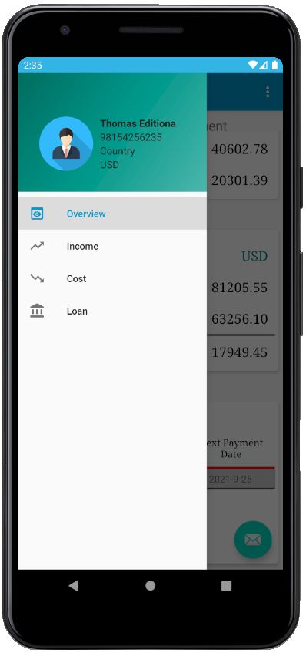
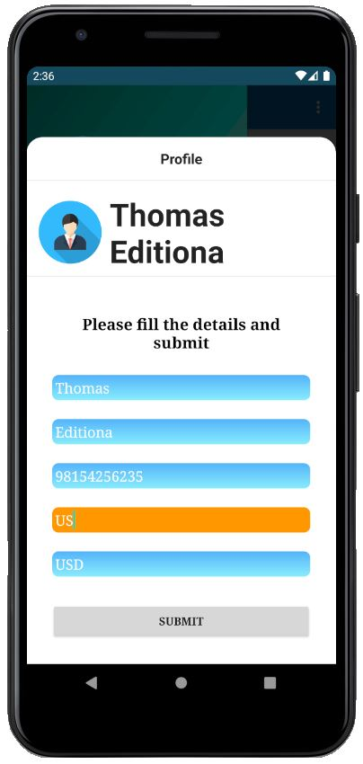
Daily Expense Tracker
Maintain your daily income
Maintain your daily cost/expenses
Maintain your loan/Leasing
Maintain your loan and leasing installment plan
Check current status of your loan and leasing account
Summarized you monthly asset
Summarized you yearly asset
Money saving plan (Budget)
Graphically view of monthly income status
Graphically view of monthly cost/expense status
Latest News Update

Slide 11
Daily Expense Tracker
Maintain your daily income
Maintain your daily cost/expenses
Maintain your loan/Leasing
Maintain your loan and leasing installment plan
Check current status of your loan and leasing account
Summarized you monthly asset
Summarized you yearly asset
Money saving plan (Budget)
Graphically view of monthly income status
Graphically view of monthly cost/expense status
Latest News Update

